Slide 1
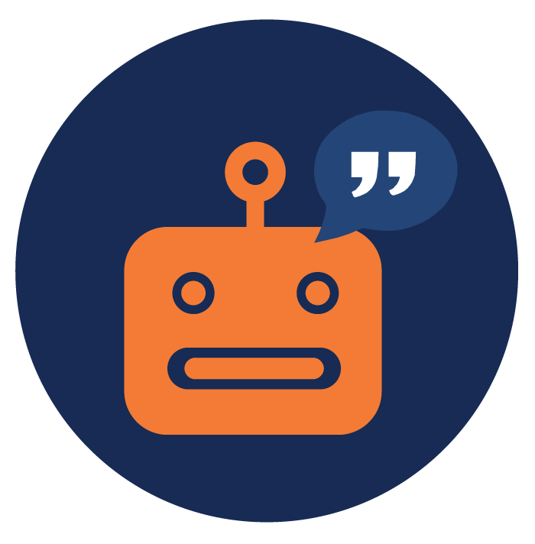
Table #2: Four-pillar chatbot strategy framework
Delivering a memorable chatbot experience is no trivial task. It requires a multi-disciplinary approach with extensive planning around four important pillars: functionality, conversational intelligence, personality and interface .
Pillar | Description | Must Have Features
Functionality | Does the chatbot do what it is supposed to do, and if so, how good is it? Are there existing alternatives (apps, websites, search engines, etc.) to accomplish the same task? | Chatbots must accomplish their primary task, outperform alternatives and have adequate domain knowledge.
Conversational Intelligence | Does the chatbot feel human? Is it witty or easily confused? Can it understand the contextual difference between “I am fine” and “’m going to be fined”? Can it retain and build on the conversation’s context? | Chatbots must have ‘human-like’ conversational capabilities and be able to preserve context throughout the chat session.
Personality | Does the chatbot have a personality? Can it indulge in humour, enter and exit gracefully? | Chatbots must have a personality that’s best suited to the domain it’s deployed in. Personalities make a strong impression.
Interface | Does the chat bot experience take you outside the chat window? Does the chat bot interact with buttons, text, voice or a combination of all of the above? | Chatbots should have interactive elements in the interface, along with the ability to handle text input and minimal external links.

